Slide 1
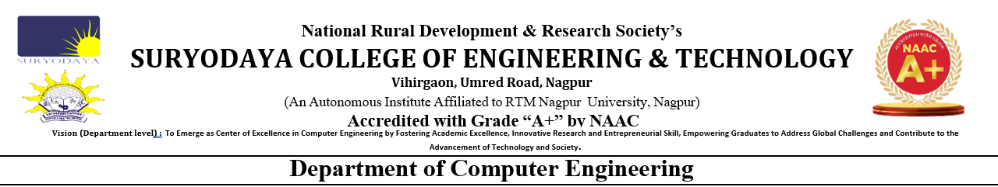
Session 2026-2027
Project Seminar On
“Realcheck Ai: Multimodal AI-Based Fake Media Detection and Prediction System”
Presented by:
Rakesh Dambhare Bhavesh Verma
Bhavik Marbade Ansh Banewar
Under the Guidance of :
Prof. Utkarsha Gode

Slide 2
CONTENTS
Introduction
Problem Statement
Objectives Of The Project
Literature Survey
Proposed System
System Architecture
Methodology
Hardware & Software
Implementation Status
Results
Advantages
Application
Future Scope
Conclusion
References
Paper Publication

Slide 3
1. INTRODUCTION
Artificial Intelligence (AI) can create highly realistic fake images and videos.
Such content can be used to spread misinformation and misleading information.
It is becoming difficult to identify fake media through manual observation.
RealCheck AI uses Deep Learning and Computer Vision to detect fake media.
The system analyzes images and videos and predicts whether they are Real or AI-Generated/Fake.
It also provides a confidence score and basic analysis of the prediction.

Slide 4
2. PROBLEM STATEMENT
AI technology can easily create realistic fake images and videos.
Fake media can be used to spread misinformation and false information.
It is difficult for users to identify fake content through manual checking.
Existing detection methods may focus on only one type of media.
There is a need for an automated system that can analyze both images and videos.
RealCheck AI aims to detect fake media and provide a prediction with confidence score.

Slide 5
3. OBJECTIVES OF THE PROJECT
Detect Fake Media – Identify AI-generated and manipulated images and videos.
Analyze Images and Videos – Provide detection through a single system.
Classify Media – Predict whether the uploaded media is Real or AI-Generated/Fake.
Provide Confidence Score – Show the confidence level of the prediction.
Provide Analysis – Give useful information to help users understand the result.
User-Friendly System – Develop a simple interface for easy media upload and detection.
Reduce Misinformation – Help users identify suspicious digital content before sharing it.

Slide 6
4. LITERATURE SURVEY
Sr. No. | Name of Paper | Year of Publication | Contribution
1 | Can ChatGPT Detect Deep Fakes? A Study of Using Multimodal Large Language Models for Media Forensics | (2024) | Studied how multimodal AI models can detect AI-generated images and deepfakes.
2 | Raising the Bar of AI-generated Image Detection with CLIP | (2024) | Used CLIP-based features to improve the detection of AI-generated images.
3 | Multi-modal Deepfake Detection via Multi-task Audio-Visual Prompt Learning | (2025) | Combines audio and visual information to improve deepfake video detection.
4 | SIDA: Social Media Image Deepfake Detection, Localization and Explanation with Large Multimodal Model | (2025) | Detects fake images, identifies manipulated regions, and provide explanations for the prediction.
7

Slide 7
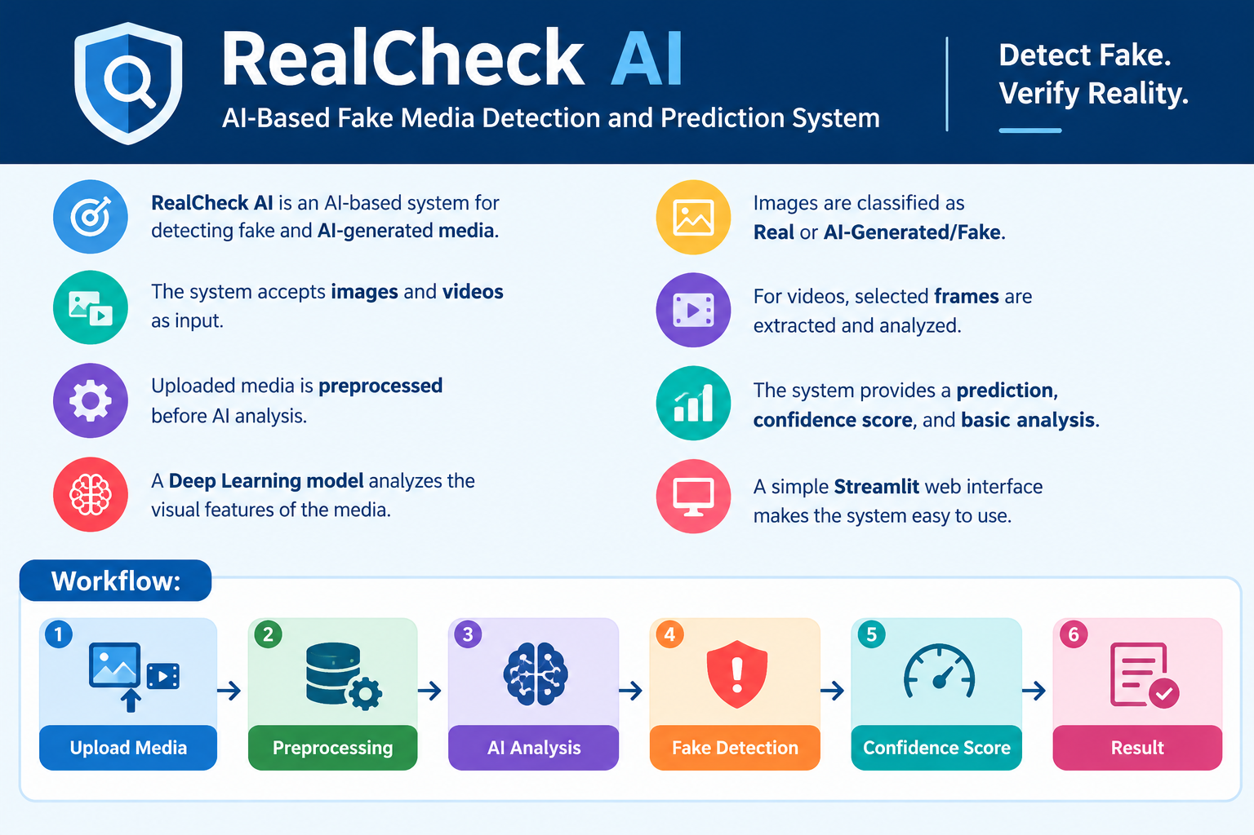
5. PROPOSED SYSTEM

Slide 8
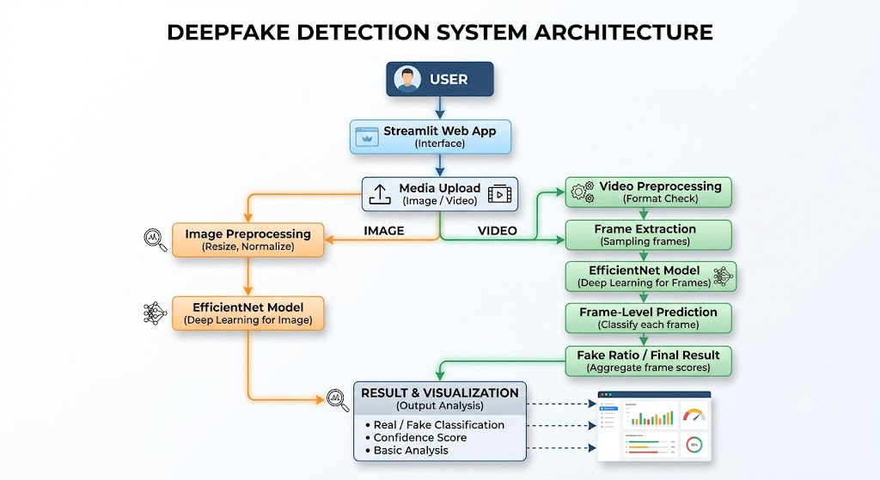
6. SYSTEM ARCHITECTURE

Slide 9
7. METHODOLOGY
RealCheck AI follows these main steps:
Data Collection
Collect real and AI-generated/fake media for training and testing.
Preprocessing
Resize and normalize images. For videos, extract selected frames.
Feature Extraction
Extract important visual features from the media.
Model Training
Train a deep learning model using real and fake samples.
Media Detection
Analyze the uploaded image or video using the trained model.
Prediction
Classify the media as Real or AI-Generated/Fake.
Result Analysis
Generate the confidence score, fake-frame ratio for videos, and basic analysis.
Result Display
Show the final result through the Streamlit web interface.

Slide 10
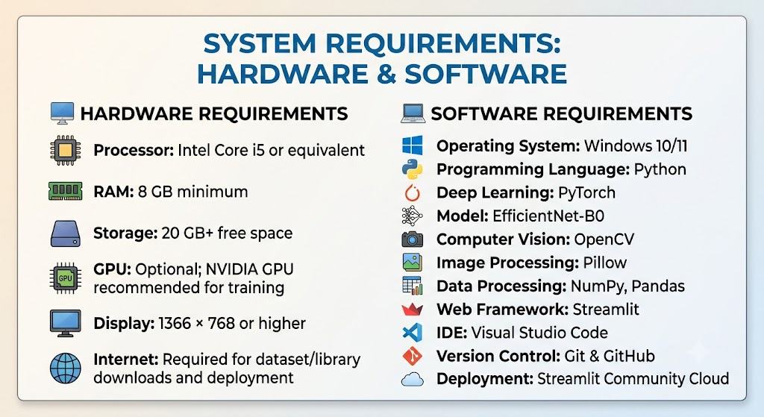
8. HARDWARE & SOFTWARE

Slide 11
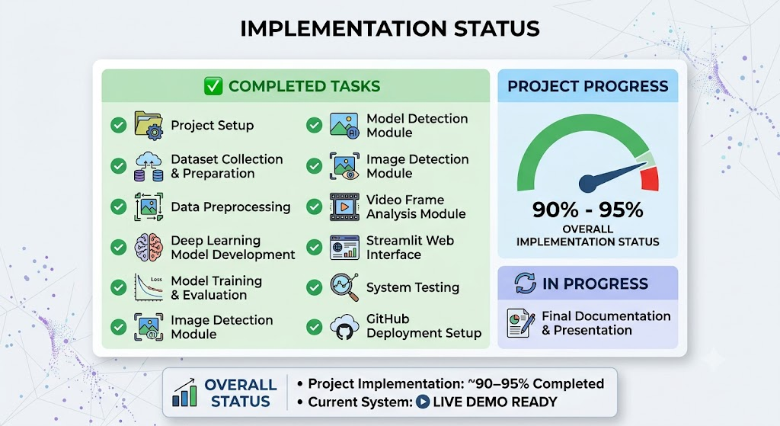
9. IMPLEMENTATION STATUS

Slide 12
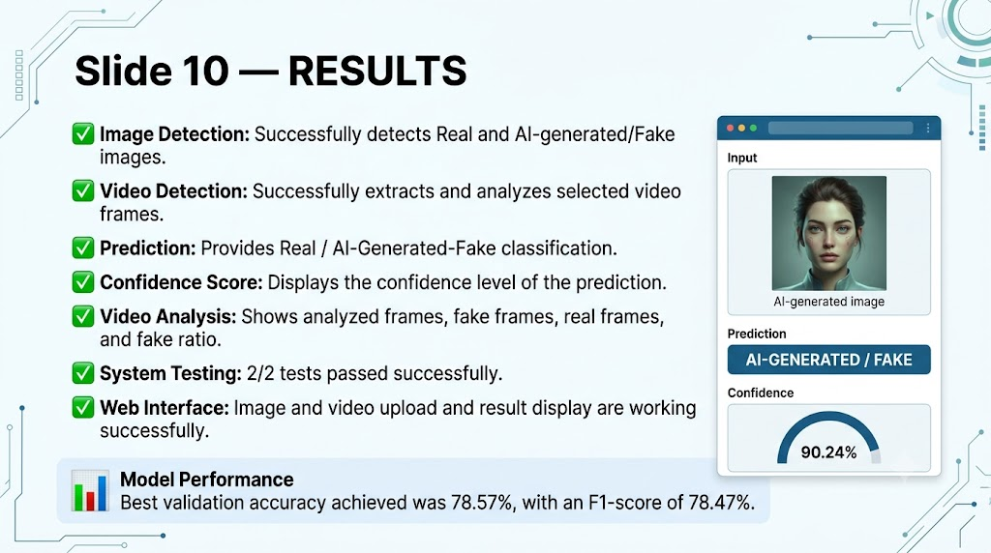
10. RESULTS

Slide 13
11. ADVANTAGES
Multimodal Detection – Detects fake content in both images and videos.
Automated Analysis – Uses AI to automatically analyze uploaded media.
Fast Detection – Provides results quickly after media processing.
Confidence Score – Shows the confidence level of the prediction.
Video Frame Analysis – Analyzes selected video frames to identify potentially fake content.
User-Friendly – Simple Streamlit interface makes the system easy to use.
Helps Reduce Misinformation – Helps users identify suspicious digital content.
Expandable – Can be improved with new datasets and advanced AI models.

Slide 14
12. APPLICATION
Social Media – Helps identify fake and AI-generated content shared online.
News & Media – Helps journalists verify suspicious images and videos.
Digital Forensics – Supports analysis of manipulated digital evidence.
Cybersecurity – Helps detect fake media used for scams and impersonation.
Education – Can be used to teach students about AI-generated content.
Government Organizations – Helps identify potentially misleading digital content.
Content Verification – Helps users check media before sharing or publishing.
AI Research – Provides a base for further research in fake-media detection.

Slide 15
13. FUTURE SCOPE
Audio Deepfake Detection – Detect AI-generated and manipulated voices.
Real-Time Detection – Analyze fake media during live streams and video calls.
Advanced AI Models – Use newer deep learning and transformer-based models.
Better Accuracy – Train the system with larger and more diverse datasets.
Explainable AI – Show the areas of an image that influenced the prediction.
Mobile Application – Develop an Android/iOS app for easy media checking.
Browser Extension – Detect suspicious media while browsing websites and social media.
Cloud-Based System – Support large-scale media analysis and multiple users.

Slide 16
14. CONCLUSION
RealCheck AI is an AI-based system for detecting fake and AI-generated images and videos.
It uses Deep Learning and Computer Vision techniques for media analysis.
The system predicts whether the uploaded media is Real or AI-Generated/Fake.
It provides a confidence score and basic analysis of the result.
The system has a simple and user-friendly Streamlit interface.
It can help users identify suspicious digital content and reduce misinformation.
In the future, the system can be extended with audio detection, real-time analysis, and advanced AI models.

Slide 17
15. REFERENCES
Goodfellow, I., Bengio, Y., & Courville, A. — Deep Learning, MIT Press, 2016.
Tan, M., & Le, Q. V. — EfficientNet: Rethinking Model Scaling for Convolutional Neural Networks, ICML, 2019.
Rossler, A., et al. — FaceForensics++: Learning to Detect Manipulated Facial Images, ICCV, 2019.
Wang, S. Y., et al. — CNN-Generated Images Are Surprisingly Easy to Spot... for Now, CVPR, 2020.
Paszke, A., et al. — PyTorch: An Imperative Style, High-Performance Deep Learning Library, NeurIPS, 2019.
Bradski, G. — The OpenCV Library, Dr. Dobb's Journal, 2000.
Streamlit Documentation — Framework for building interactive Python-based web applications.
Kaggle — Datasets and resources for machine learning and computer vision.

Slide 18
16. PAPER PUBLICATION

Slide 19

Thank You !

